Slide 1
QUIZ – Who said it?
If you judge people, you have no time to love them.
I have no special talent. I am only passionately curious.
Family is the most important thing in the world.

Slide 2
QUIZ – Who said it?
Ask not what your country can do for you, but what you can do for your country.
I wandered lonely as a cloud…
I have a dream…
For me to live is Christ…

Slide 4
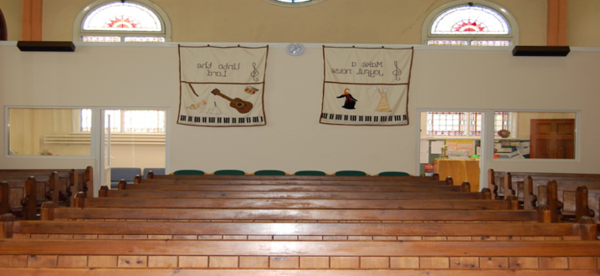
Philippians 1: 12 -26
KEY VERSE – 21
“For to me to live is Christ
And to die is gain”

Slide 5
?? A check up for Christians??
Getting the most out of being a Christian

Slide 6
Getting the most out of being a Christian
Where you live matters!
Compare 1: 7 -9
In a Roman prison – not much fun
He loves adventure and he can’t move
He loves being with (Christian) friends and he’s isolated

Slide 7
Getting the most out of being a Christian
What about us?
I’d be complaining about my circumstances and feeling let down by God!
Paul - Read 1: 9 - 11

Slide 8
Getting the most out of being a Christian
Paul’s evaluation
Compare 1: 12 -14
Served to advance the Gospel
Evangelistic opportunities
Encouragement for believers

Slide 9
Getting the most out of being a Christian
What about us?
How do we evaluate our circumstances?
Home? Health? Holidays?
Restrictions?

Slide 10

Getting the most out of being a Christian
Paul’s evaluation
Compare 1:15 -18
What really matters - Christ is preached
His (Christian) opponents
His Christian partner
“because of this,
I rejoice”

Slide 11

Getting the most out of being a Christian
What about us?
How important is it that the Gospel is being shared
In church, in our home, at work?
Around the world?

Slide 12
Getting the most out of being a Christian
Paul’s expectation
Compare 1: 19 -29
For me – “not be ashamed”,
- “fruitful labour”
For you – progress and joy in the faith
- your joy in Christ Jesus will overflow

Slide 13
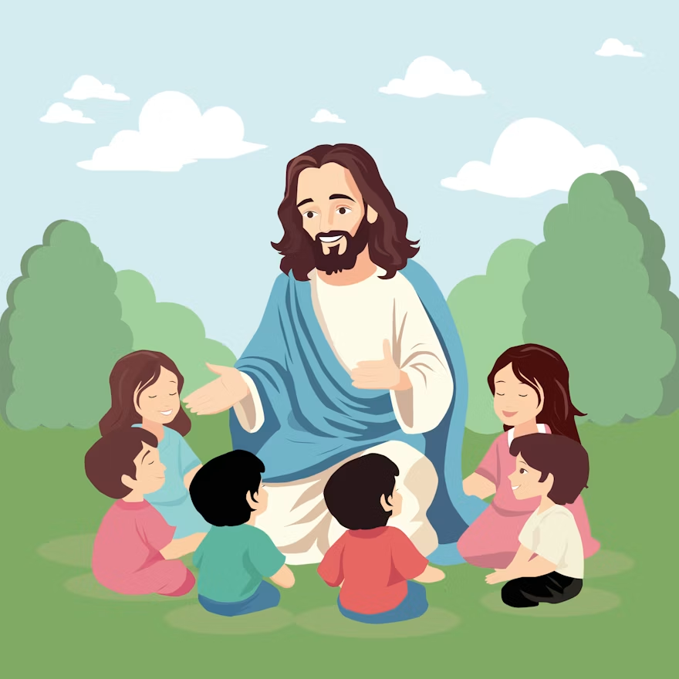
Getting the most out of being a Christian
What about us?
Do we care more about what people think of us (clothes, leisure activities) than about people knowing Jesus?

Slide 14
Getting the most out of being a Christian
Paul’s aspirations for them
Compare 1: 27 -30
Live worthy of the Gospel
Stand firm
Be prepared to suffer

Slide 15


Getting the most out of being a Christian
What about us?
Our aspirations for family & friends?
For family members
Success? Wealth?
Happiness?
Follow Christ fully?

Slide 16
Getting the most out of being a Christian
“For to me to live is Christ
And to die is gain”

Slide 17
“And to die is gain”
Getting the most out of being a Christian
Getting ready for our future

Slide 18
“And to die is gain”
Getting the most out of being a Christian
Paul’s way
Trusting…
Jesus’ PROMISES
The Father’s TIMING
The Spirit’s GLIMPSES

